Slide 1
A Geovisual Framework with Open Data for Novice Users
Michael Crowder
Lauren Darr
Gerardo Garza
Brent Allan

Slide 2
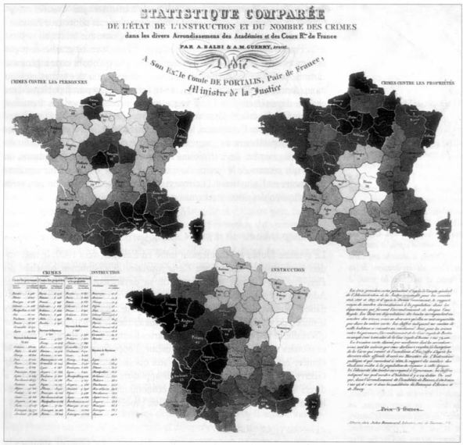
Crime Mapping
1830s Guerry maps crime rates and education in France
Birth of criminology and sociology
1990s crime mapping goes digital
Police adoption of digital maps remains complicated

Slide 3
Crime Mapping
Multi-purpose:
Shaping policy/strategy
Public transparency and engagement
Expectation:
Police operate, use technology similarly
Reality:
Resources and computing/analysis capacity range widely
Police User
Citizen User

Slide 4
Crime Mapping
# of officers: 1-30,000
Majority of agencies < 10 officers (Banks and Hickman, 2016)
More factoids about the small agency v. large, mapping, etc.

Slide 5
Police Open Data
Open data should mean that data is open and available
While data is available is it really open to the public?
Is open data really open at all?
Yes and no
Does the public know what or how to use
Comma-separated values (.csv)
JavaScript Object Notation (JSON)
Application Programming Interface (API)

Slide 6
Motivation behind Geovisual Framework
Two phase motivation
Open Data – data that is freely available for use and redistribution by anyone for any purpose. http://opendatahandbook.org/glossary/en/terms/open-data/

Slide 7
Motivation behind Geovisual Framework
Two phase motivation
Open Data – data that is freely available for use and redistribution by anyone for any purpose. http://opendatahandbook.org/glossary/en/terms/open-data/

Slide 8
Motivation behind Geovisual Framework
Two phase motivation
National Incident-Based Reporting System (NIBRS)
New crime reporting standard starting in 2021
Allows up to 10 offenses per incident
Higher level detail on less serious crimes

Slide 9
Motivation behind Geovisual Framework
Two phase motivation
National Incident-Based Reporting System (NIBRS)
New crime reporting standard starting in 2021
Allows up to 10 offenses per incident
Higher level detail on less serious crimes

Slide 10
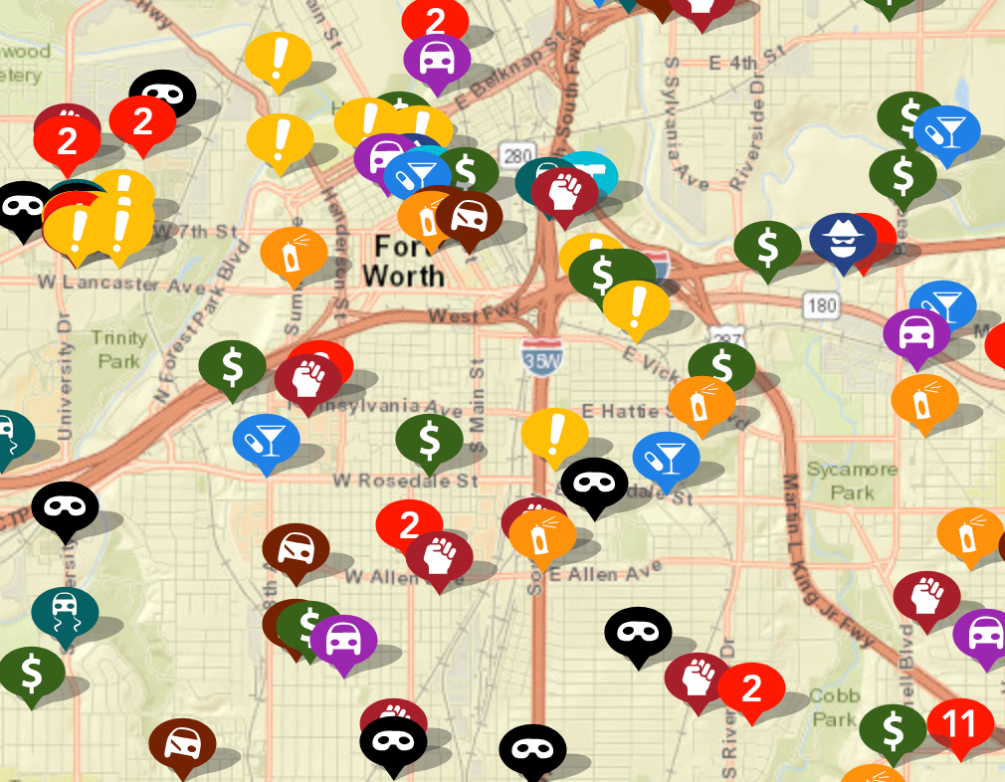
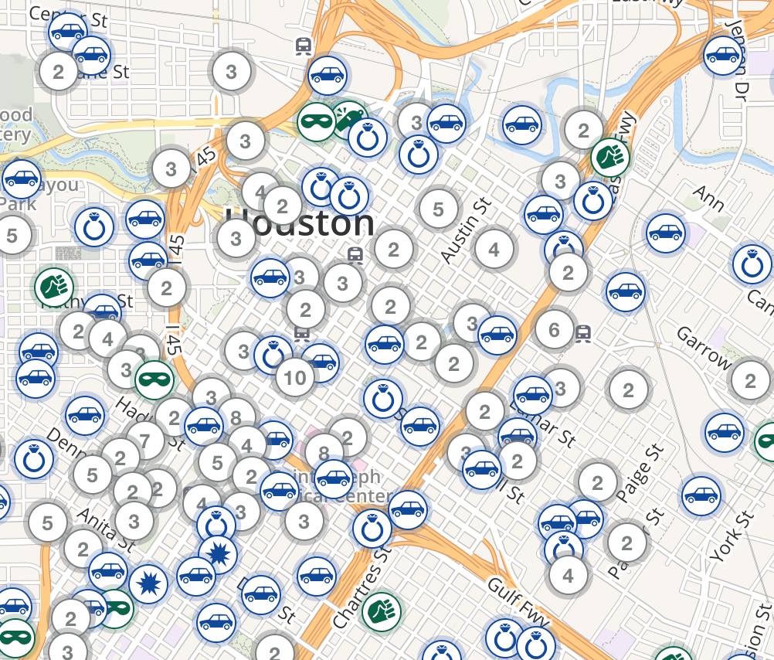
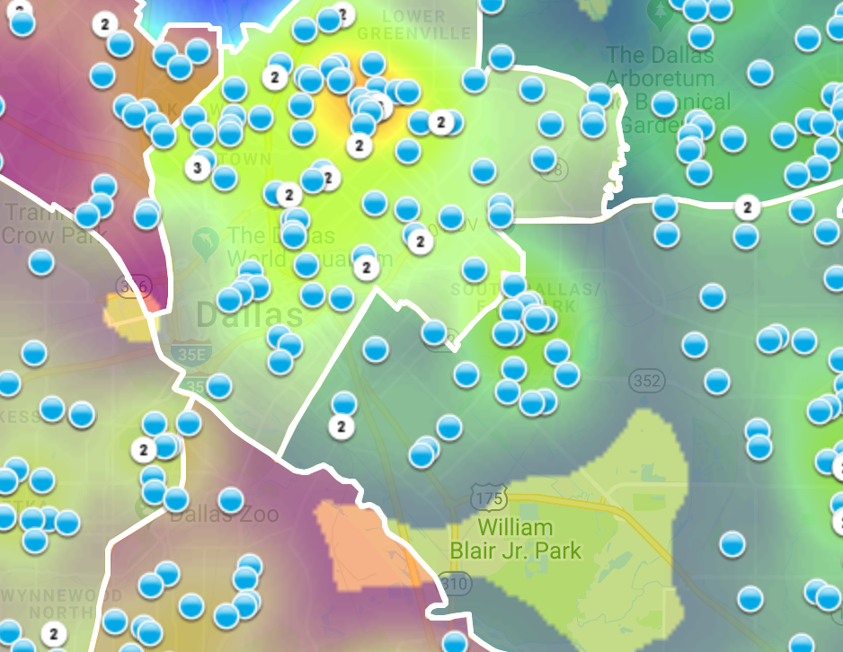
Motivation behind our Geovisual Framework
Currently, no standards exist for geovisual framework to display criminal activity on digital maps.
https://www.crimemapping.com/
https://www.crimereports.com
https:www.cityofirving.org

Slide 11
Data Source
Data source
City of Dallas Open Data Portal
Police Incident Data
386K Rows
103 Columns
2015 - 2018
Our mapping focuses on burglaries
Ability to segment
Not an overwhelming number like breaking into cars

Slide 12
Data Source
Data source
City of Dallas Open Data Portal
Police Incident Data
386K Rows
103 Columns
2015 - 2018
Our mapping focuses on burglaries
Ability to segment
Not an overwhelming number like breaking into cars

Slide 13
Map Making
Mapping handled through open-source products
R
Leaflet – Open-source JavaScript library

Slide 14
Map Making
Mapping handled through open-source products
R
Leaflet – Open-source JavaScript library

Slide 15
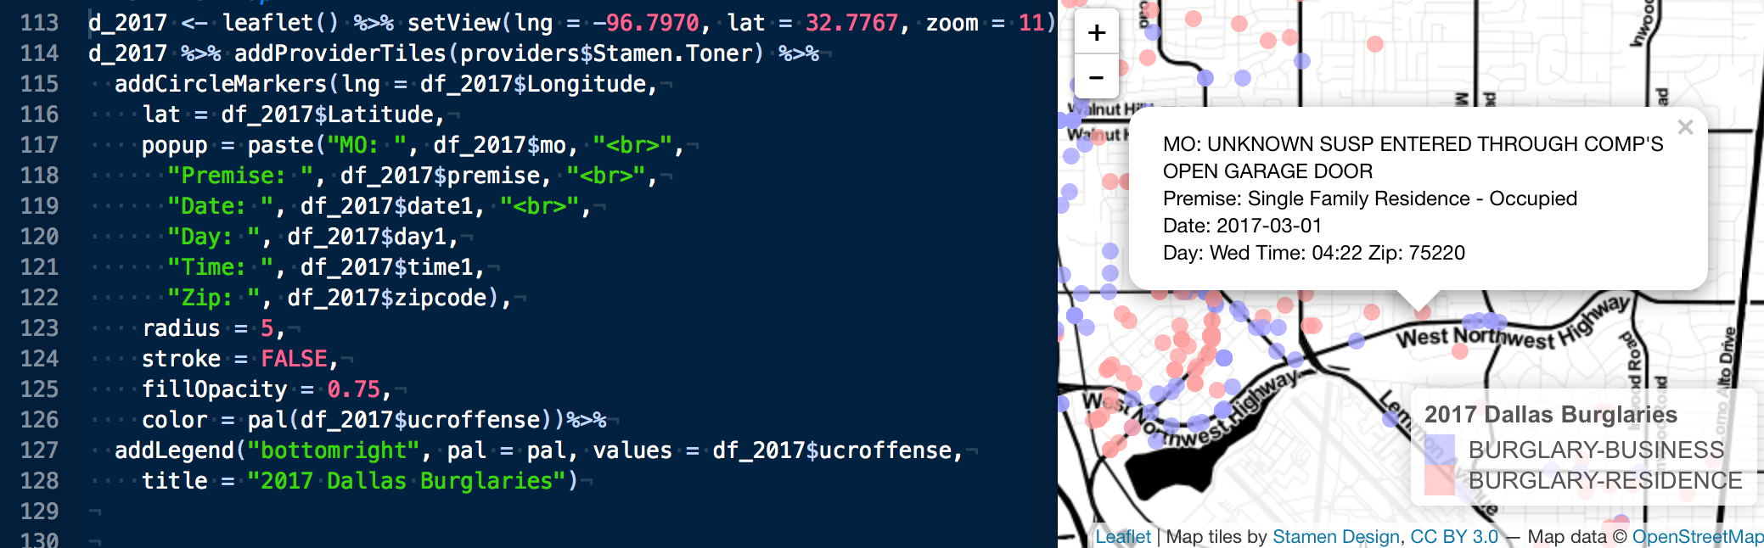
Map Making
Mapping handled through open-source products
R
Leaflet – Open-source JavaScript library

Slide 16
Intro to framework
Law Enforcement Agencies
On Average employ 68 people
31% are civilians
That’s around 20 people to run

Slide 17
Intro to framework
Law Enforcement Agencies
On Average employ 68 people
31% are civilians
That’s around 20 people to run
911 Operators
Dispatchers
Forensics
Mechanics
HR
Finance
https://www.bjs.gov/content/pub/pdf/lpd13ppp.pdf

Slide 18
Intro to framework
Law Enforcement Agencies
On Average employ 68 people
31% are civilians
That’s around 20 people to run
911 Operators
Dispatchers
Forensics
Mechanics
HR
Finance
https://www.bjs.gov/content/pub/pdf/lpd13ppp.pdf

Slide 19
Intro to Framework
Law Enforcement Agencies
On Average employ 68 people
31% are civilians
That’s around 20 people to run
911 Operators
Dispatchers
Forensics
Mechanics
HR
Finance
https://www.bjs.gov/content/pub/pdf/lpd13ppp.pdf

Slide 20
Geovisual Framework
Interactive
Time Bound
Contain variable(s)
Data Colors
Base Maps
Map Types

Slide 21
Geovisual Framework
Interactive
Time Bound
Contain variable(s)
Data Colors
Base Maps
Map Types

Slide 22
Interactivity
Cartographic Interaction
Roth

Slide 23
Interactivity
Interaction

Slide 24
Interactivity

Slide 25
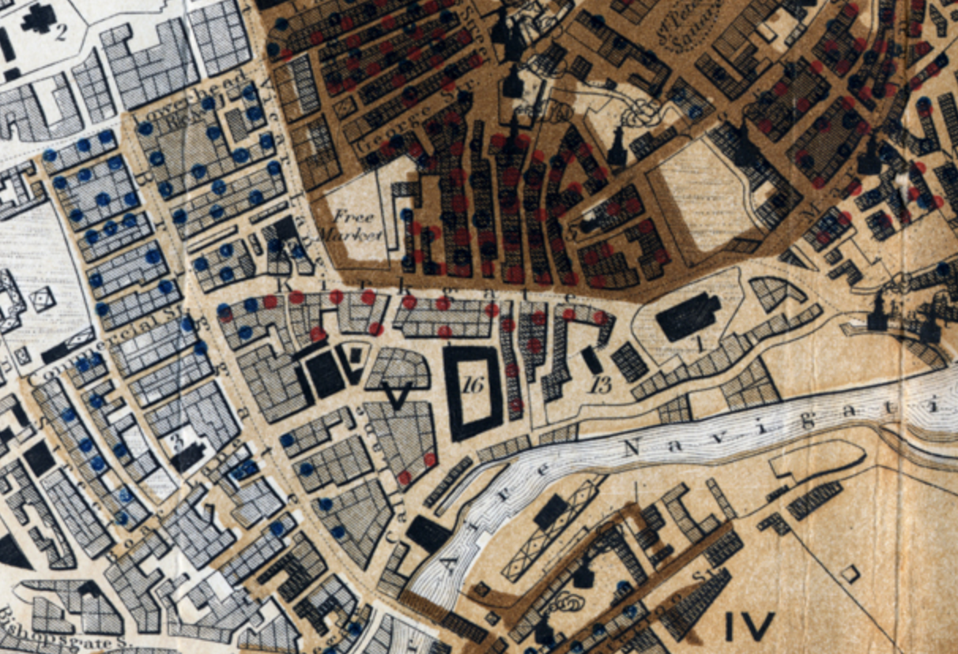
Color
The goal of color in a map is to give a clear visual indication of what is happening on the earth.
“Sanitary Map of the Town of Leeds” 1842
Blue dots are cholera
Orange dots are other contagious diseases

Slide 26
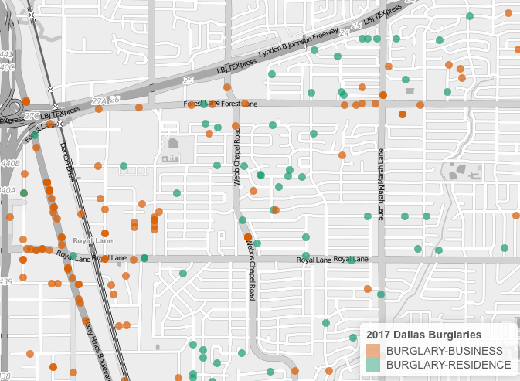
Color
Graphically showing the difference between entities by using color

Slide 27
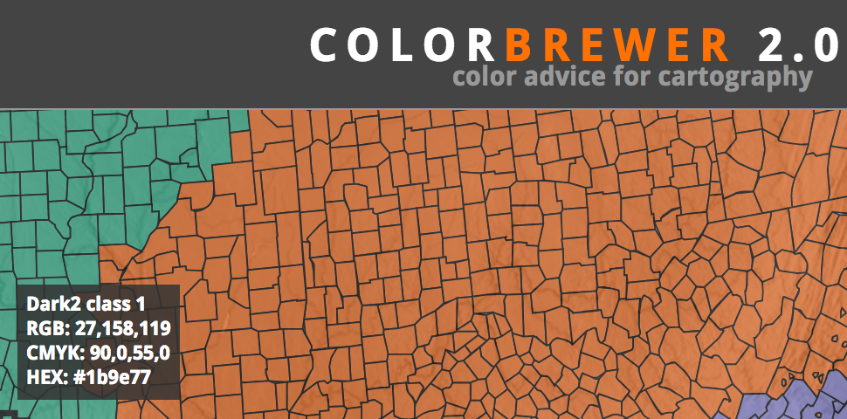
Color
Graphically showing the difference between entities by using color
Color Brewer
Online tool for selecting color schemes for maps.

Slide 28
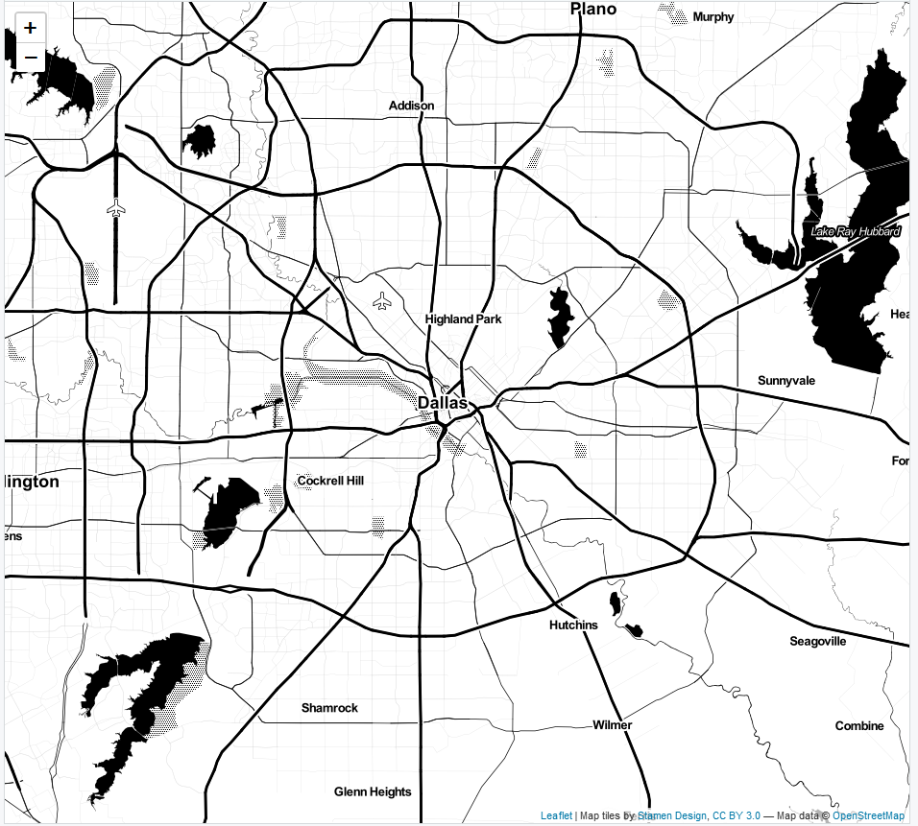
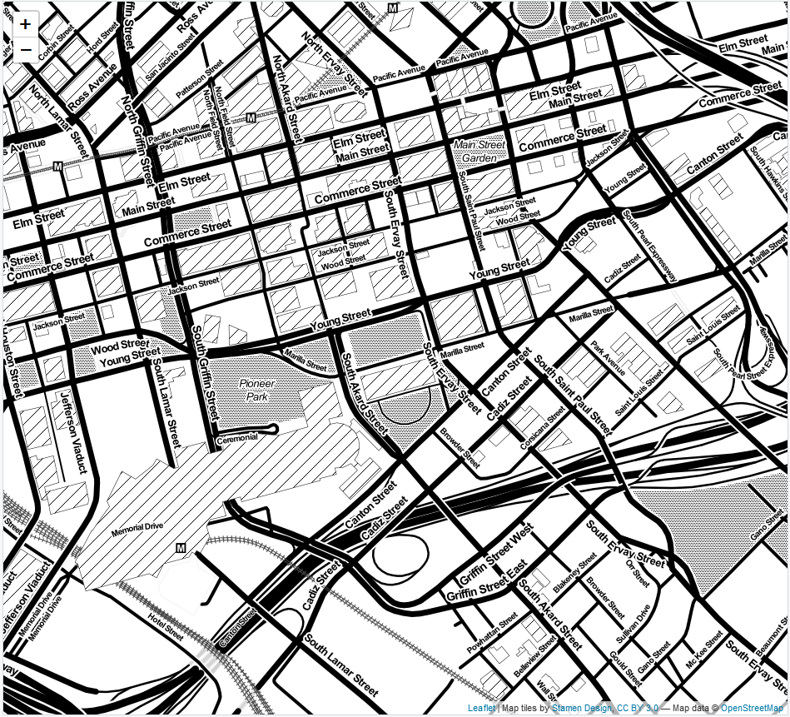
Basemaps
Zoom: ‘11’
Zoom: ‘16’
Leaflet, 3rd party, or custom map tiles
Landscape of chosen design and detail
Layering capability
2-lines of code

Slide 29
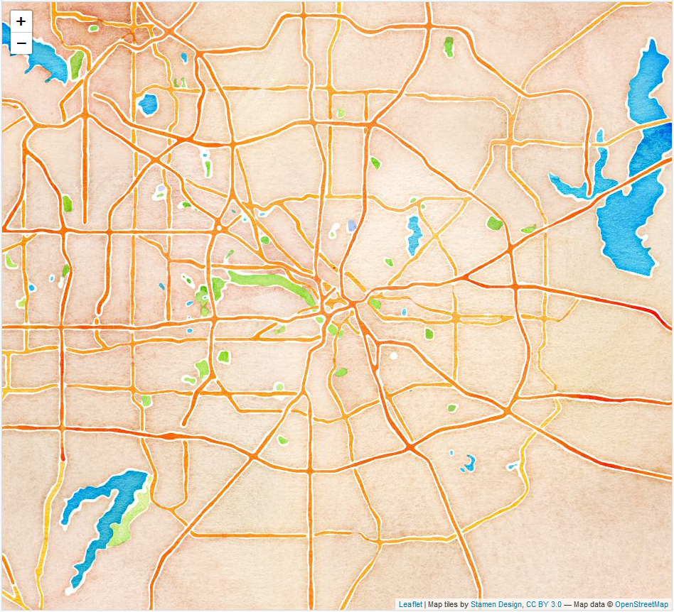
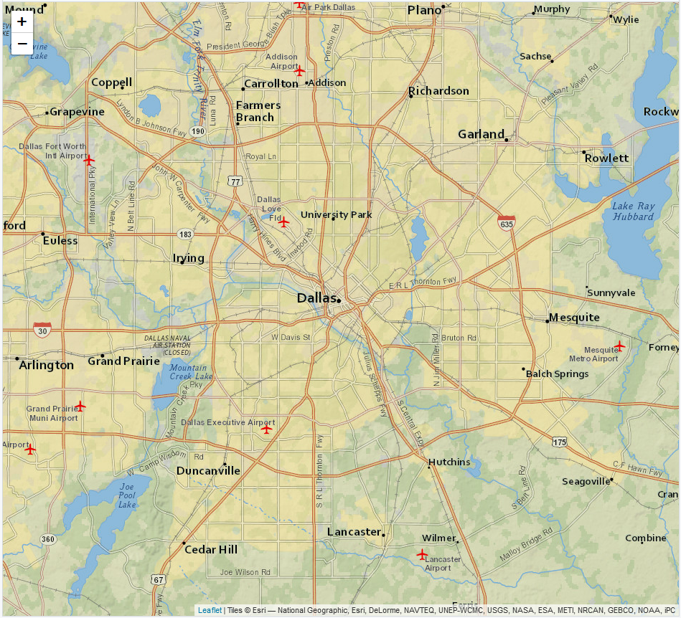
Basemaps
Artistry v. Clarity
Watercolor
Zoom: ‘11’
NatGeo
Zoom: ‘11’

Slide 30
Map Types
Dot Map
Discrete, multiple variables
View of landscape
Dot size can be misleading
Opacity for density
*Map examples*

Slide 31
Map Types
Dot Map
Map examples

Slide 32
Map Types
Cluster Map
Solution to densely populated dot map
Mouse over feature
‘Spiderfy’ shows individual objects on zoom
Computationally more efficient than dot

Slide 33
Map Types
Cluster Map
*Map examples

Slide 34
Map Types
Heat Map
Density, higher level view
Heat v. Hot Spot important distinction
Single variables

Slide 35
Map Types
Heat Map
*Map examples

Slide 36
Variable Selection
# NIBRS Incident types
Can’t display all variables at once
What are most useful for citizens?
Careful to choose several together

Slide 37
Variable Selection
*Examples

Slide 38
Deployment & Conclusion

Slide 39
Deployment & Conclusion

Slide 40
Deployment & Conclusion

Slide 41
Deployment & Conclusion

